Slide 1

Candy’s Fantastic Tips
Waste Education System game design
Notes:
1. The main audience of Waste Education System is college students. However, if we create a more interactive interface, this application could be suitable for wilder community. Such as primary school students.

Slide 2

Character-Candy
Why use character?
More interactive
Story telling ( Make introducing information
not so boring)
Close to daily life
Gamification
Candy can:
Introduce waste management information
Introduce each game
The character of games
Give project a more interesting name
Hi I’m Candy,
I will show you some tips!
Candy
Notes:
1.We keep the character of Candy. She is not only a role of game, but also an assistant for information introducing.
2.The main purpose of our project is to educate students or other players about waste management. But the term of education is a bit boring. Candy could make information teaching and gaming more attractive.

Slide 3
The name of our project
Other Options
Candy’s Fantastic Tips
Candy’s Mid-break
Arrival Campus
Candy’s Hub
Resort Queen
Waste Education System
Notes:
1.Based on the character, we can give our project a more fascinating name.
2.The name could be a combination of character and university or some other interesting titles.
3.I just list some optional names.

Slide 4
Game Line
Generate waste
The game line is linear
Resort and regenerate waste games are designed as a circulation, which could be play many times
The trouble of waste
Resort waste
Replay
Replay
Regenerate
waste
Replay
Notes:
1.There are 4 games follow an logic game line.
2.The 1st game is to tell us people generate waste very time.
3.The 2ed game is to tell us that much waste causes serious problems.
4.The 3rd game is to tell us people need to resort these waste , and sort them correctly.
5.The 4th game is to tell us people could obtain new resources form recycling waste.
6.The 3rd and 4th games are the most important 2 among 4 games.
7.So we design these 2 games as a loop. It means that player need to replay these tow games many times.
8.By replaying 3rd and 4th game again and again, players could acquire strong impression of waste resorting.

Slide 5
Game design
1
2
Waste rain
Products
Click
Waste
Control the bar to protect the earth
Generate waste
The crisis of waste
Notes:
1.The 1st game is aimed to simulate resource consumption.
2.Products emerge from each grid and disappear shortly. Player need to click it. Then this product would be marked as consumed.
3.The 2ed game is to simulate the crisis great amount waste bring to us.
4.Waste rain falls down and player needs to control a bar to protect the earth which is at the bottom.

Slide 6
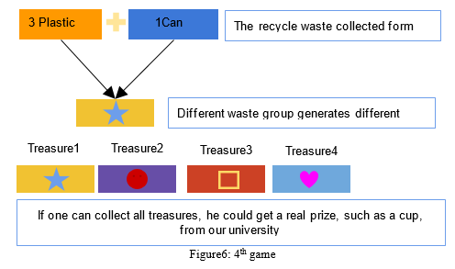

Game design
3
4
Replay
Sequence of waste
Use FaceBook to share waste
Resort waste
Regenerate waste
Notes:
1.The 3rd game is the most important one which is designed to simulate waste resorting.
2.Different types of waste come along as a sequence. Player need to drag the one on the head to the correct recycle bin.
3.The correctly resorted waste would be used in next game. So it means player need to resort waste many times.
4.The 4th game is to simulate waste regenerate. It could be very simple.
5.Plare just need to combine the waste he resorted correctly in last game to generate new resource which is called treasure in our project.
6. Different waste combination produces different treasure. So we add social net work in this game for players to share there waste with their friend. For example, player could exchange or require specific waste with his friends by FaceBook.
7.If player could collect all treasures. He could get an prize from university like a T-shirt or a cup. This action could greatly increase players’ participation.

